Slide 1
Deployment of Node Apps

Slide 2
Deployment of Node Apps
Node apps can be deployable on :
1. Heroku
2. Microsoft Azure
3. Ubuntu
4. Docker
5. Digital Ocean

Slide 3
6 Steps to deploy on google cloud engine
Step 1 : Setup Node
Download and install NodeJS
Install ExpressJS
npm install express
Step 2 : Setup Google Cloud SDK
If you are using Linux or Mac, use below commands
$ curl https://sdk.cloud.google.com | bash $ exec -l $SHELL
If you are using windows, download google-cloud-sdk
, (install python 2.7 to run this google cloud sdk)
>.appspot.com

Slide 4
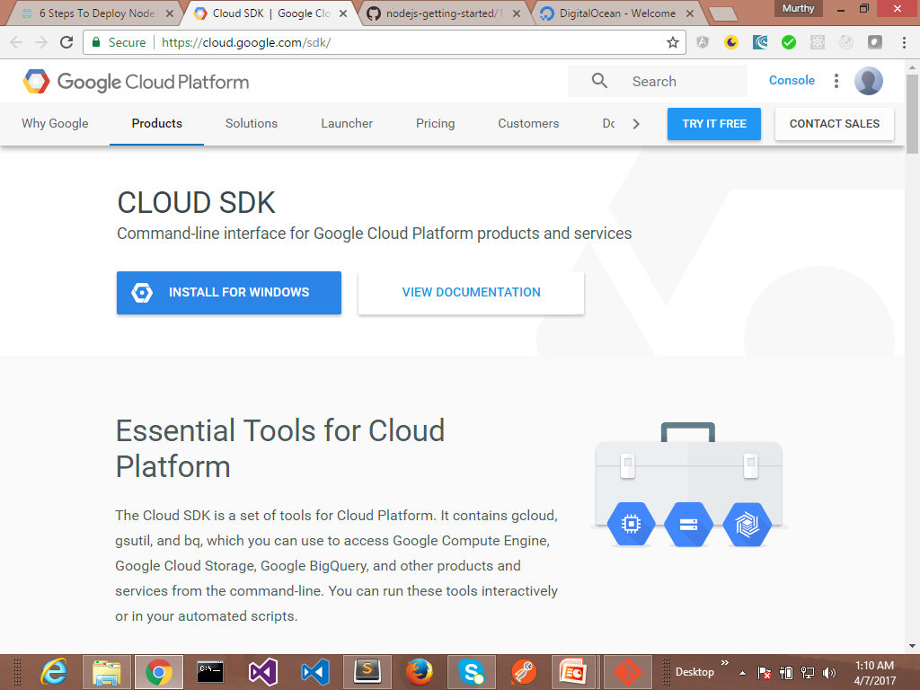
6 Steps to deploy on google cloud engine

Slide 5
6 Steps to deploy on google cloud engine
Step 3 : Create app in google cloud plateform
Open the Cloud Platform Console.
In the drop-down menu at the top, select Create Project.
Click Show advanced options. Under App Engine location, select a India location.
Give your project a name.
Note the Project ID because it will be used for commands and in configurations.

Slide 6
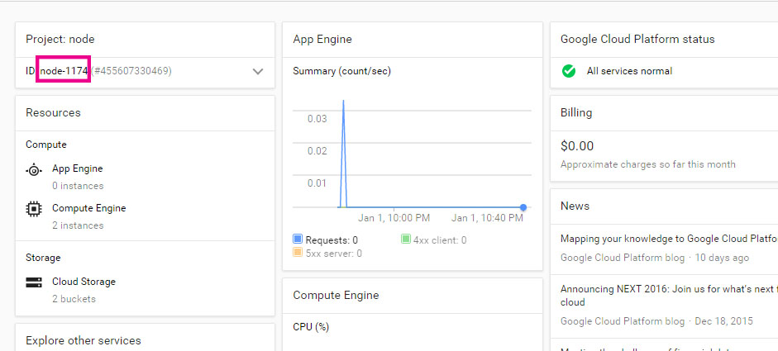
6 Steps to deploy on google cloud engine

Slide 7
6 Steps to deploy on google cloud engine
Step 4 : Initiate Google Cloud SDK
Execute below command to initiate Google cloud sdk
gcloud init
Now it will ask for authentication, ( it will show you web browser, there you need to enter your google account credentials).
Once after successful authentication, it will ask you for app id. Enter app id that you have created in above step

Slide 8
6 Steps to deploy on google cloud engine
Step 5 : Create Hello World NodeJS app
Lets create NodeJS hello world app. Here you need these below files to create first hello world app.
app.js - Main code to run app
app.yaml - important for google app engine, Which specifies runtime as NodeJS
package.json - this file contains different types of data like version, name of the app. Minimum nodejs version required to run app..etc

Slide 9
6 Steps to deploy on google cloud engine
Step 6 : Deploy App
Run below command on above hello world app directory.
gcloud preview app deploy app.yaml --promote
Wait for some time. Once after you app deployed, you can check your app at
https://<your-app-id

Slide 10
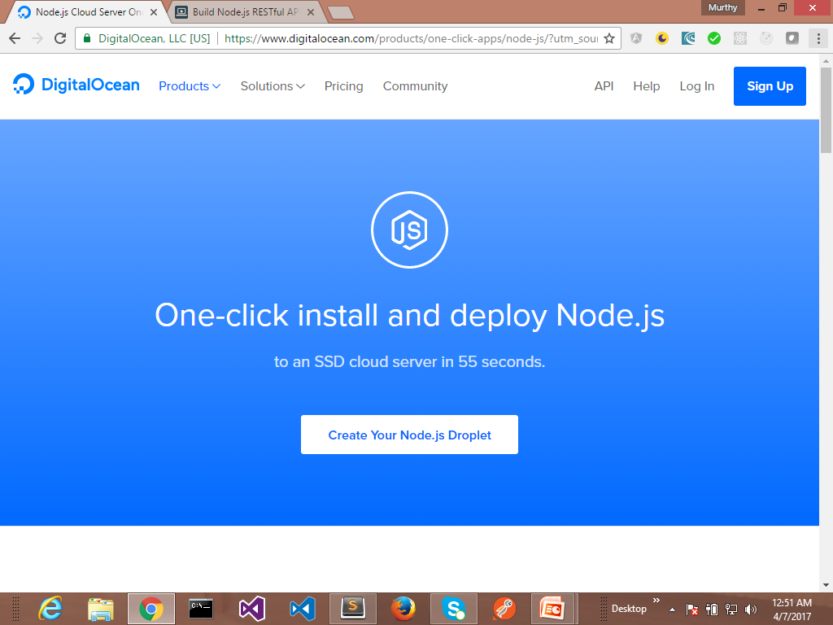
Deployment of Node Apps
Node apps can be deployable on :
1. Heroku
2. Microsoft Azure
3. Ubuntu
4. Docker
5. Digital Ocean

Slide 11
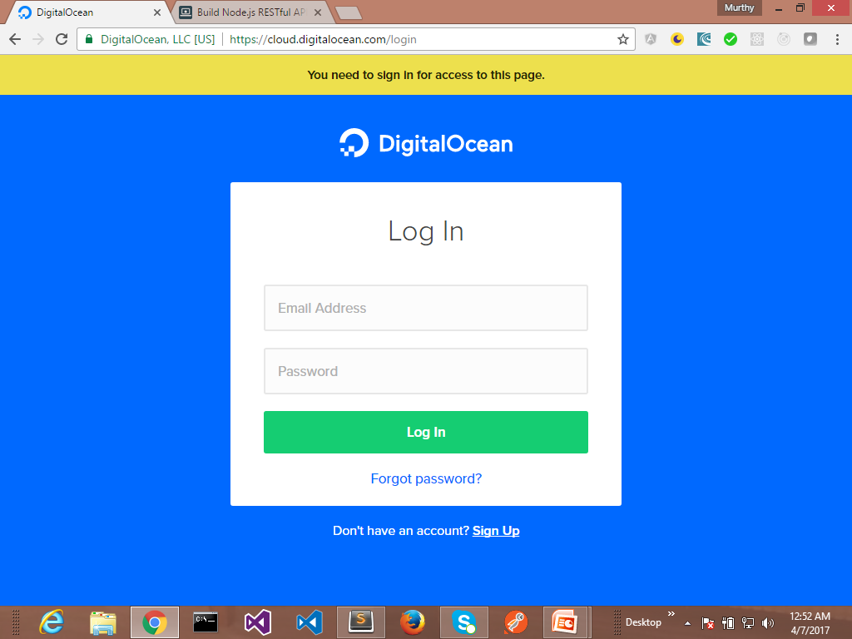
Deployment of Node Apps
Node apps can be deployable on :
1. Heroku
2. Microsoft Azure
3. Ubuntu
4. Docker
5. Digital Ocean

Slide 12
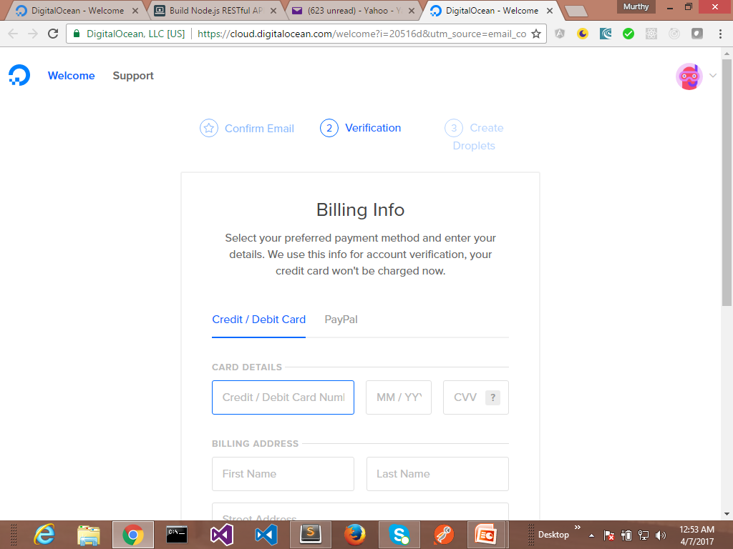
Deployment of Node Apps
Node apps can be deployable on :
1. Heroku
2. Microsoft Azure
3. Ubuntu
4. Docker
5. Digital Ocean

Slide 13
Deployment of Node Apps

Slide 14
Deployment of Node Apps on Heroku
What is Heroku?
Heroku is a cloud platform that lets companies/individuals build, deliver, monitor, and scale apps.
Heroku offers PaaS type of cloud computing, the delivery of computing services — servers, storage, databases, networking, software, and more — over the Internet (“the cloud”).

Slide 15
Deployment of Node Apps on Heroku
Benefits of Heroku:
Easy deployment
It uses git commands
Security
Plenty of Add-on resources (applications, databases)
Processes scaling — independent scaling for each component of your app without affecting functionality and performance
Isolation — each process is completely isolated from each other thorough Documentation

Slide 16
Deployment of Node Apps on Heroku
prerequisites to deploy app:
Node.js and npm installed.
A Node.js app.
A free Heroku account.
The Heroku CLI.

Slide 17
Deployment of Node Apps on Heroku
Prerequisites to deploy app:
Node.js and npm installed.
A Node.js app.
A free Heroku account.
The Heroku CLI.

Slide 18
Steps to deploy on Heroku
Login to your Heroku via the command line heroku login. This will prompt for credential.
(Optional) Add Procfile to your application echo ‘web: ./node_modules/.bin/forever -m 5 server.js’
>Procfile
In the case of Node.js, it will start a default web process via the start script in your package.json.
scripts:{ ‘start’:’foreever server.js’},….

Slide 19
Steps to deploy on Heroku
3. Create Heroku remote repository
heroku create appName
4. Add the new changes made to the app
git add
5. Commit the snapshot
git commit -m “Added a Procfile.”
6. Push to your app to the newly created heroku remote repository
git push heroku master

